Slide 1
Ch 7 High Fidelity Face Generation
Mahmoud Ahmed

Slide 2
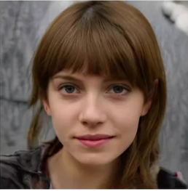
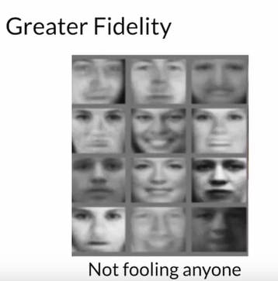
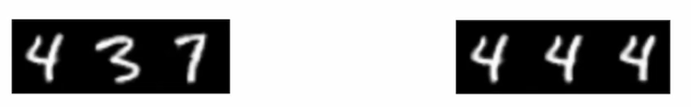
Style GAN Goals
Greater Fidelity on High-resolution Images
Increased Diversity on outputs
More Control Over Images features

Slide 3
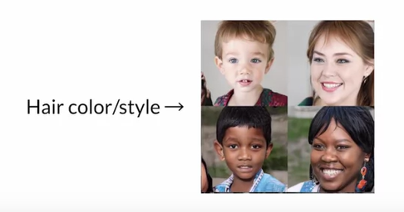
More Feature Control

Slide 4
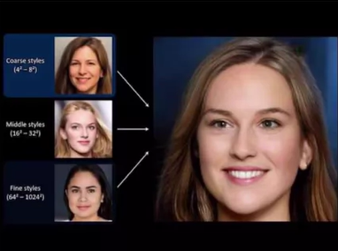
Style in GANs
Can be any variation in the image, from larger, coarser styles to finer, more detailed styles
Style made of block where in the earlier block we can control face structure and
In the final block we can edit the hair color and eye shape

Slide 5
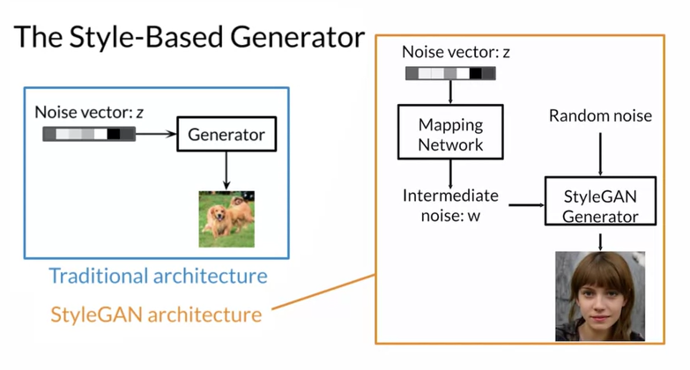
The Style based generator
Intermediate noise is injected to the Style GAN multiple times .
W’s is not imported easier instead the style is extracted from it and add to different part of the style GAN generator and this injection done through something called AdaIn.

Slide 6
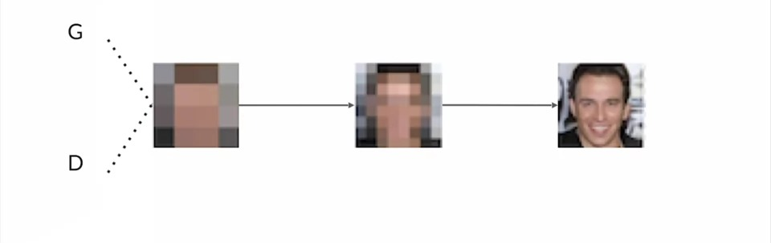
Progressive Growing

Slide 7
Problem
Generative Adversarial Networks, or GANs for short, are an effective approach for training deep convolutional neural network models for generating synthetic images.
A problem with GANs is that they are limited to small dataset sizes, often a few hundred pixels and often less than 100-pixel square images.
Notes:
1710.10196.pdf (arxiv.org)

Slide 8
Generate Large Images by Progressively Adding Layers
A solution to the problem of training stable GAN models for larger images is to progressively increase the number of layers during the training process.

Slide 9
Progressive GAN
Progressive Growing GAN is an extension to the GAN training process that allows for the stable training of generator models that can output large high-quality images.
Progressive Growing GAN requires that the capacity of both the generator and discriminator model be expanded by adding layers during the training process.

Slide 10
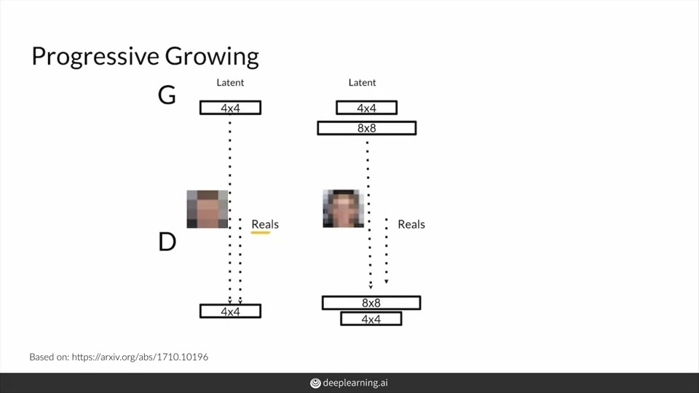
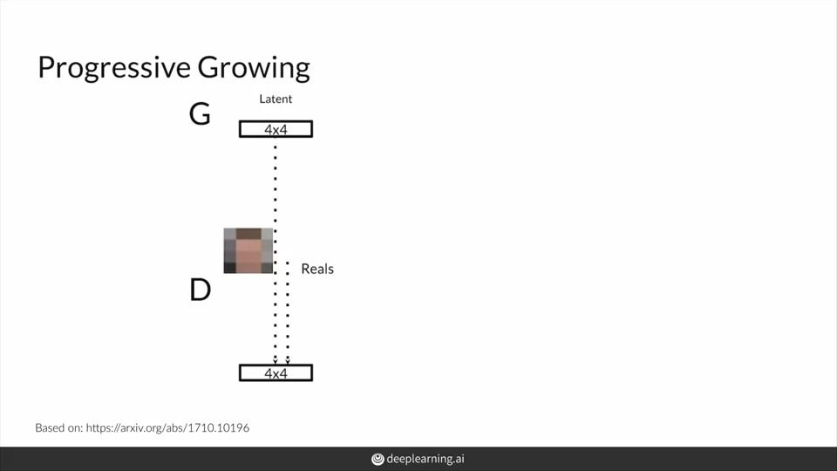
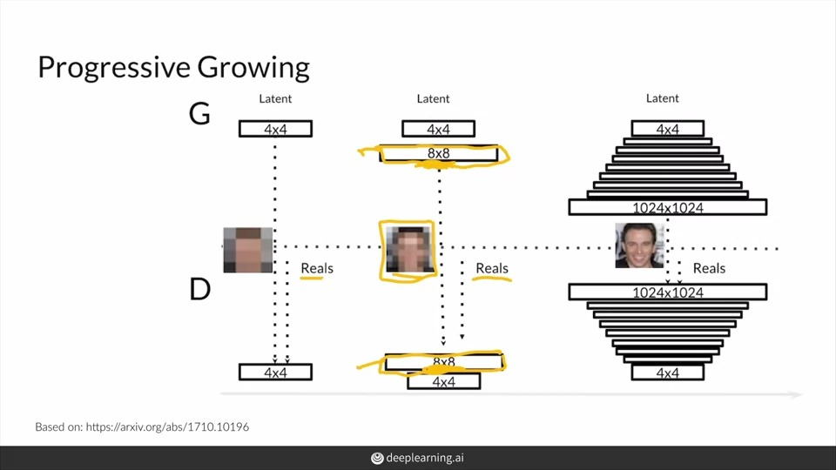
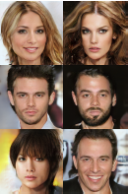

Slide 11
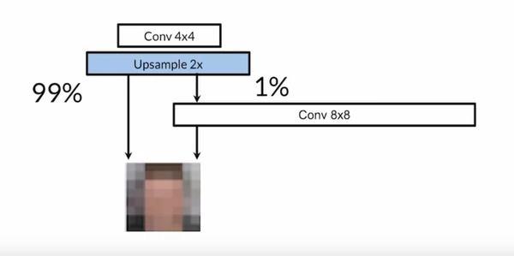
Progressive Growing :Generator

Slide 12
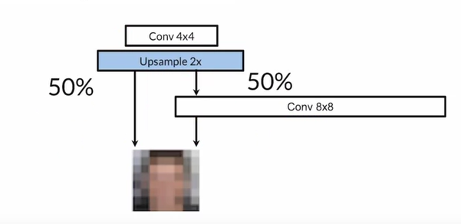
Progressive Growing :Generator

Slide 13
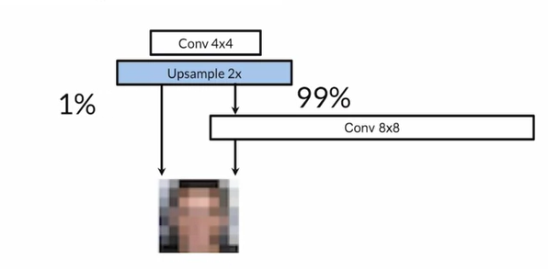
Progressive Growing :Generator

Slide 14
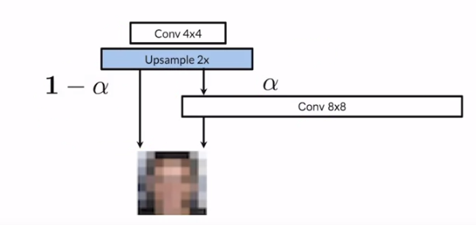
Progressive Growing :Generator

Slide 15
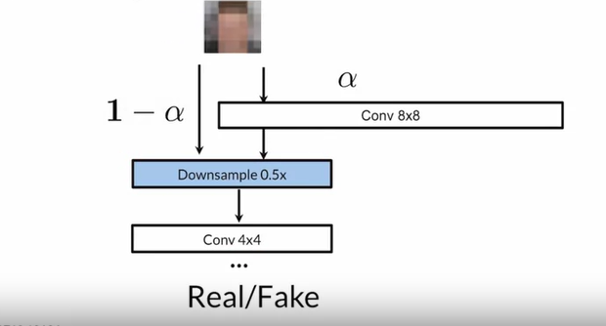
Progressive Growing : Discriminator

Slide 16
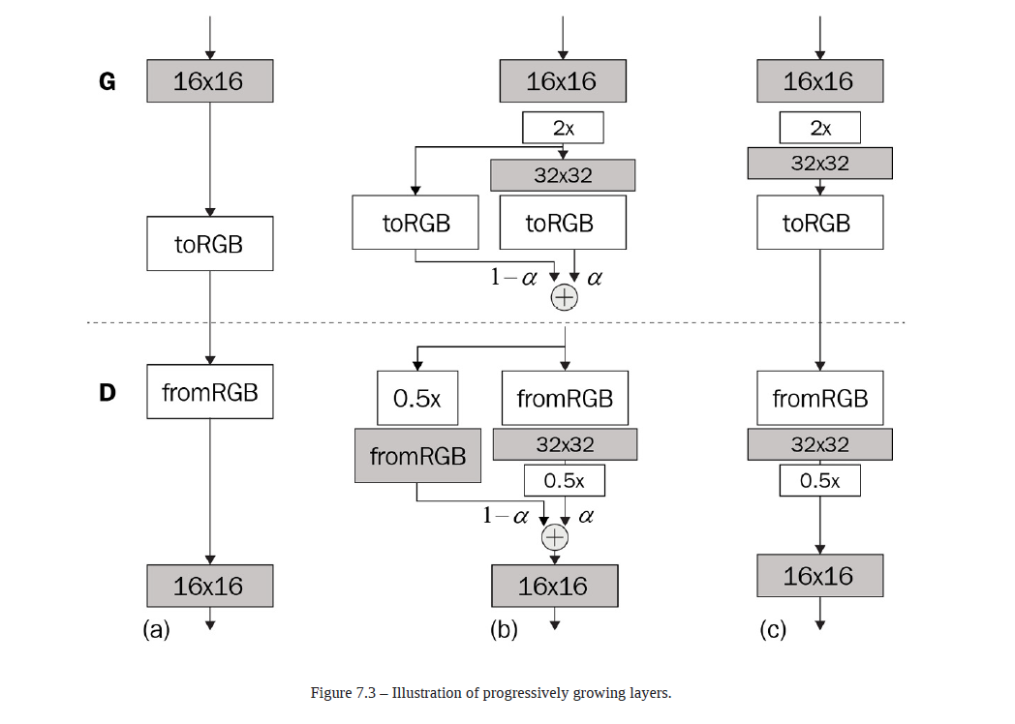
Progressively growing the network (Fad_in)
Now, assume the network is at 16x16, meaning there are already layers at the lower resolutions of 8x8 and 4x4. Now we are about to grow the 32x32 layer. However, if we add a new untrained layer to the network, the newly generated images will look like noise
and will result in a huge loss. This can in turn result in exploding gradients and destabilize the training.
To minimize this disruption, the 32x32 image generated by the new layer is not used immediately. Instead, we upsample the 16x16 image from the previous stage and fade in with the new 32x32 image. Fade is a technical term in image processing that refers to gradually increasing the opacity of an image.

Slide 17
Progressively growing the network

Slide 18
Pixel Normalization
Is introduced to eliminate the covariant shift
the covariant shift come from when the training and test data doesnot come from the same distribution so the batch norm try to help by make sure the distrubtion is the same

Slide 19
Pixel Normalization
Normalization of pixels is a process that changes the range of pixel intensity values in an image
Batch normalization should reduce the covariate shift, but the ProGAN authors did not observe that in the network training.
Therefore, they ditched batch normalization and used a custom normalization for the generator, known as pixel normalization. On a separate note, other researchers later found that batch normalization doesn't really solve the covariate problem despite stabilizing deep neural network training.
Anyway, the purpose of normalization in ProGAN is to limit the weight values to prevent them from growing exponentially.

Slide 20
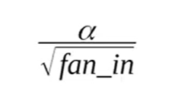
Equalized learning rate
During Gan training, numbers at layer output my rise to very high values
ELR is used to keep training process stable using the FCL and Conv
Weights are initialized using Normal distribution
At Run Time , weights are multiplied with
Take the conv layer and multiple everything with a scale and the scale come from he initialization
Fan_in Is the number of inputs to produce 1 output
Notes:
Alpha is an Adjustable gain parameter and it is 1 in StyleGAN 2

Slide 21
Mini batch statistics (std)
One way to encourage more variation is to show the statistics of a minibatch to the discriminator. The statistics from a minibatch are more varied compared to only a single instance, and this encourages the generator to generate images that show similar statistics.
Batch normalization uses minibatch statistics to normalize the activation, which in some way serves this purpose, but ProGAN doesn't use batch normalization. Instead, it uses a minibatch layer that calculates the minibatch standard deviation and appends it to the activation without changing the activation itself.

Slide 22
Mini batch statistics …
The steps to calculate minibatch statistics are as follows:
1. Calculate the standard deviation for each feature in each spatial location over the minibatch – in other words, across dimension N.(for every example across every batch a cross every channel )
2. Calculate the average of these standard deviations across the (H, W, C) dimensions to arrive at a single scale value.
3. Replicate this value across the feature map of (H, W) and append it to the activation. As a result, the output activation has a shape of (N, H, W, C+1).
All they get is a single value and the replicate it to create a single channel then concatenate it to our input

Slide 23
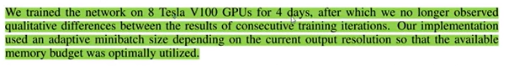
Implementation part ProGAN

Slide 24
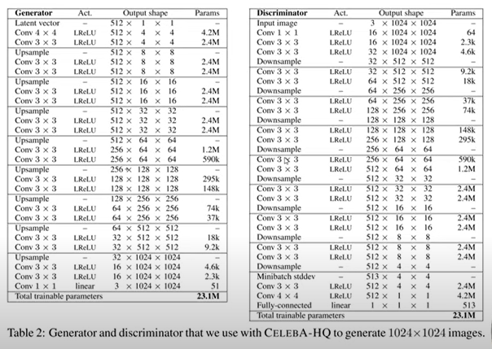

Slide 25
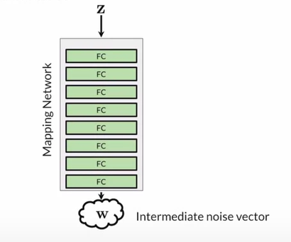
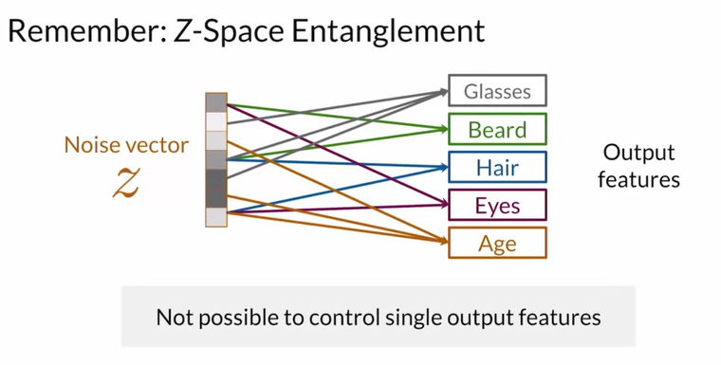
Noise Mapping Network (StyleGAN)
MLP w/8 Layers
W Still the same size as Z but we change the values
And this will get you more Disentanglement

Slide 26
Noise Mapping Network ..
this is bad because this doesn't allow for a lot of fine grained control or feature level control that you would like in your resulting image.
the real data that you know has a certain probability density.
Meaning that there is a probability of the sample of certain image having glasses on, or not having glasses on. Having a beard, having a certain color of hair, eyes, or certain age associated with them
But because Z has is normal prior, where you draw all your values from this normal distribution. It can be hard for it to map this normal distribution to the correct density distribution of all your output features.

Slide 27
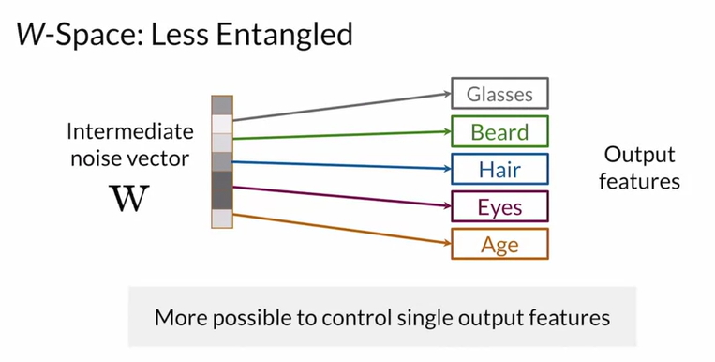
Noise Mapping Network (StyleGAN)
So it can allow for that space, and now this is called W-Space. To match the real data's density and this makes it easier to learn a one-to-one mapping, that's disentangled
This is just a graphic, it's just less entangled than Z-Space,

Slide 28
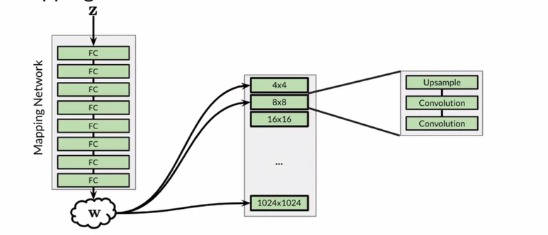
Noise Mapping Network (StyleGAN)
W doesn’t go at the beginning of the network And this is because the authors are style, again, actually found no noticeable difference from adding it there. So we put in W there or not was basically the same thing. So instead of inputting W at the very beginning, what the model starts with is actually just a constant value.

Slide 29
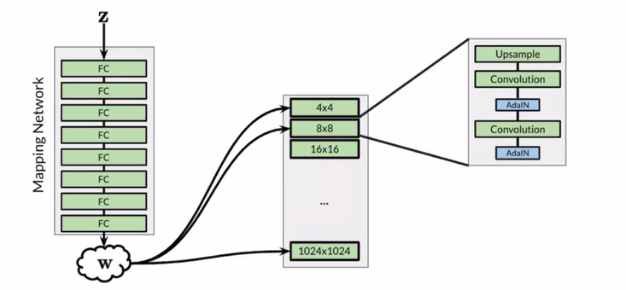
Adaptive Instance Normalization (AdaIN)
how your intermediate noise vector is actually integrated into the network
AdaIN actually comes in after each convolutional layer.

Slide 30
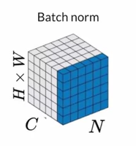
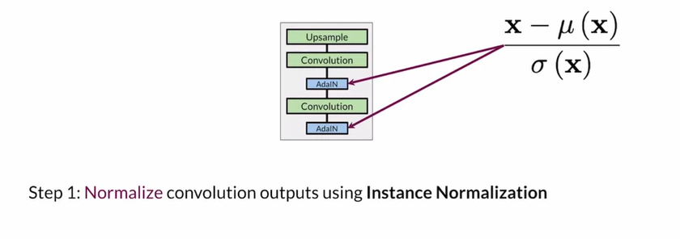
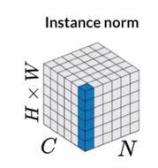
AdaIN …
But it in mean of 0 and SD of 1

Slide 31
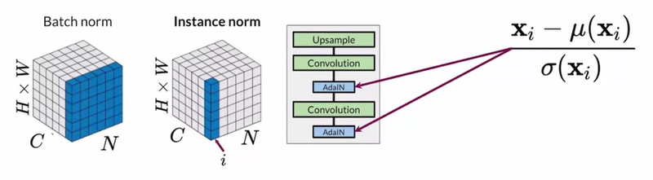
AdaIN …
But it in mean of 0 and SD of 1

Slide 32
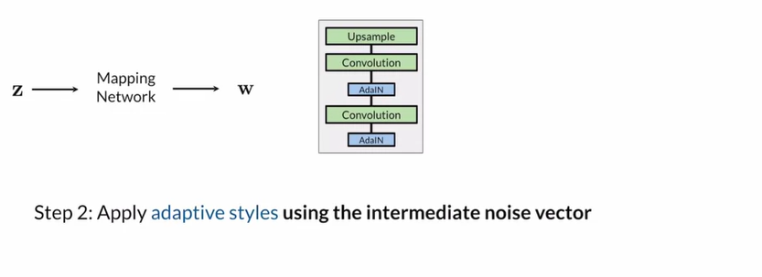
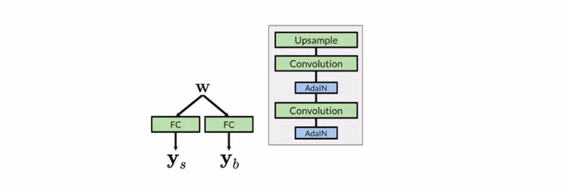
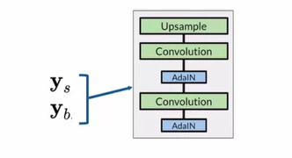
AdaIN …

Slide 33
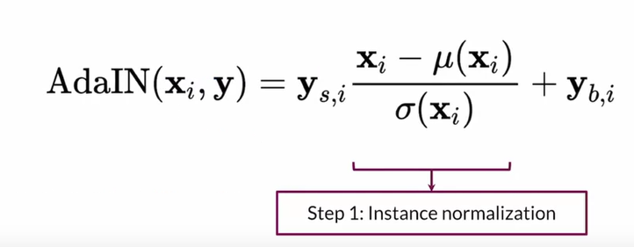
AdaIN …

Slide 34
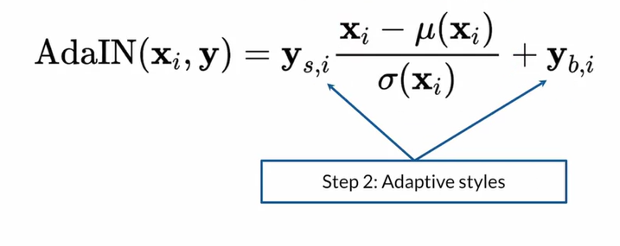
AdaIN …

Slide 35
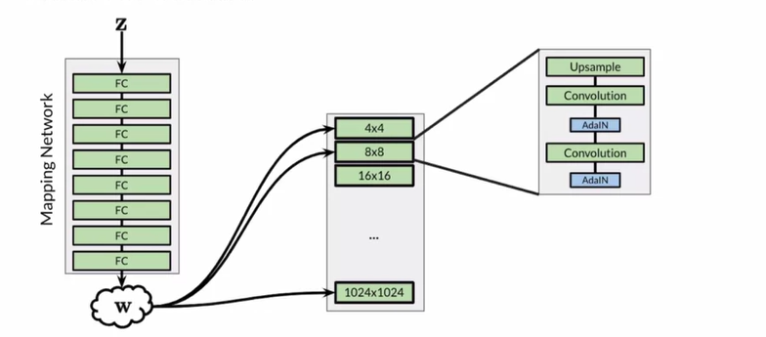
Zooming out

Slide 36
Thank you

